Slide 1
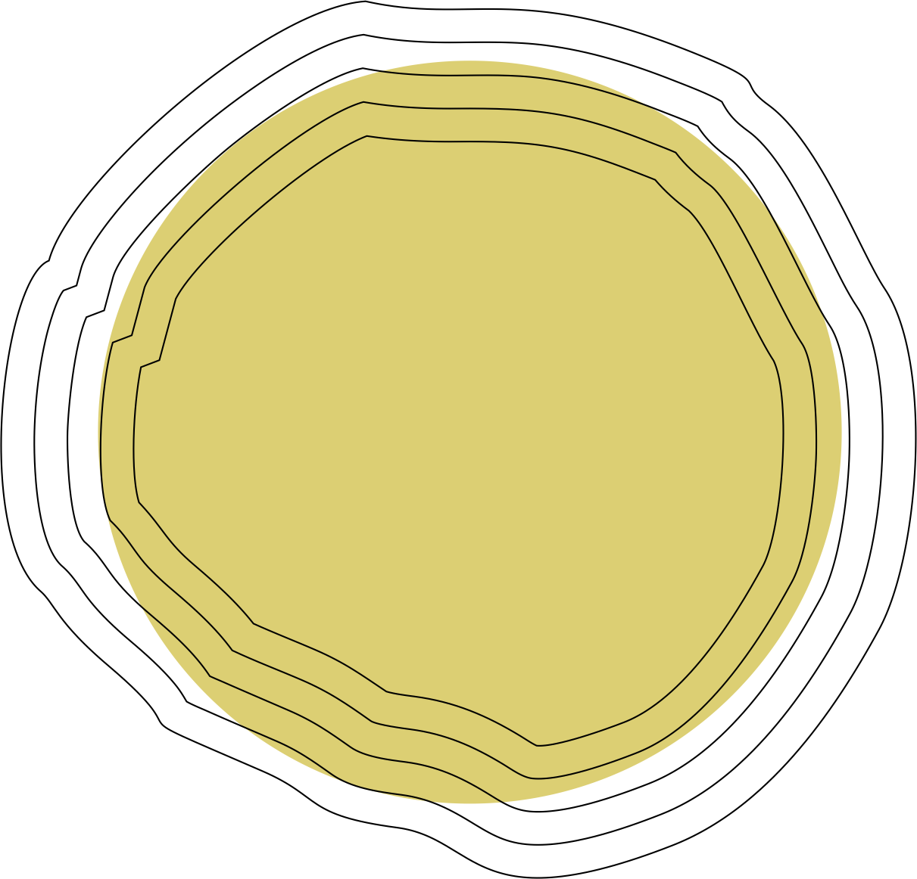
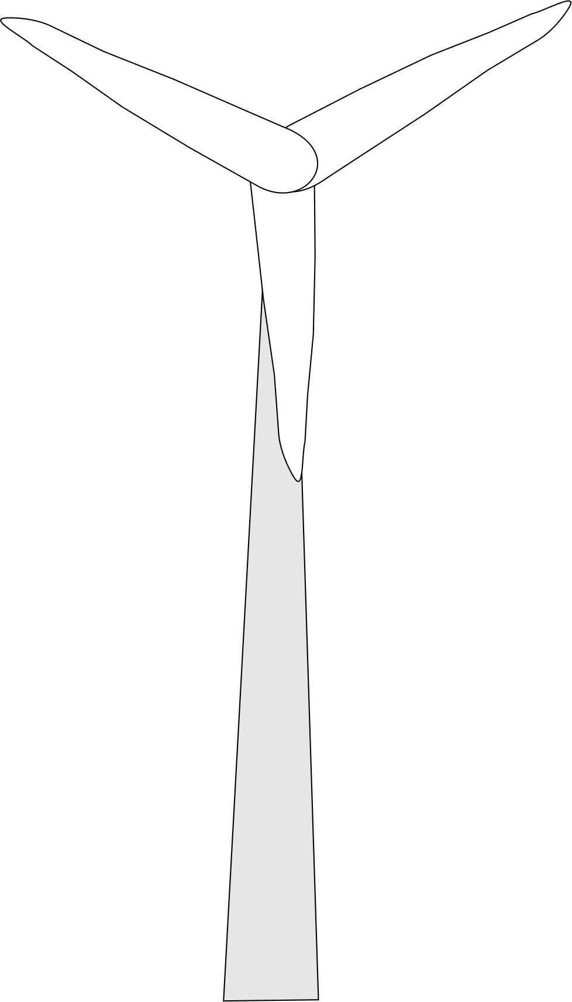
NET ZERO ENERGY BUILDINGS

Slide 2
KNOWLEDGE SERIES
WEEKLY WEBINARS BRINGING INDUSTRY EXPERTS TO SHARE KNOWLEDGE AND SHOWCASE INNOVATION TO GROW ENGAGEMENT FOR NZEBs IN INDIA

Slide 3
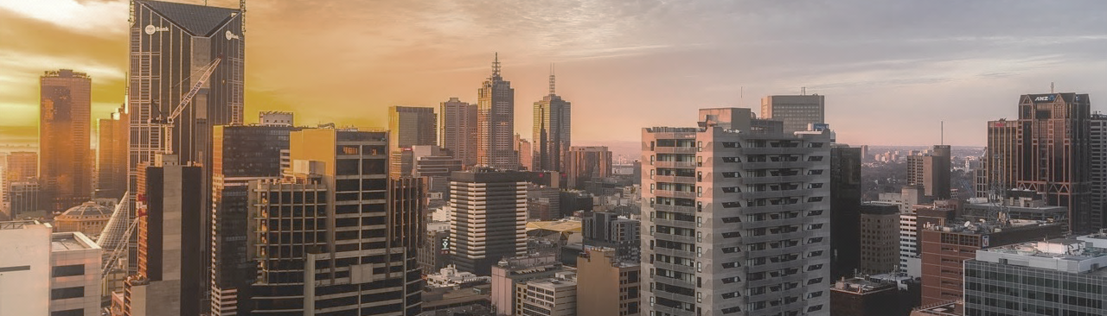
An initiative under
MAITREE
MARKET INTEGRATION AND TRANSFORMATION FOR ENERGY EFFICIENCY

Slide 4
MAITREE
MARKETINTEGRATION AND TRANSFORMATION FOR ENERGY EFFICIENCY
USAID led Market Integration and Transformation for Energy Efficiency (MAITREE) program is a four-year bilateral program, with the Ministry of Power.
MAITREE is supporting efforts moving towards a super-efficient and Net Zero Energy target for buildings in India.

